Slide 1
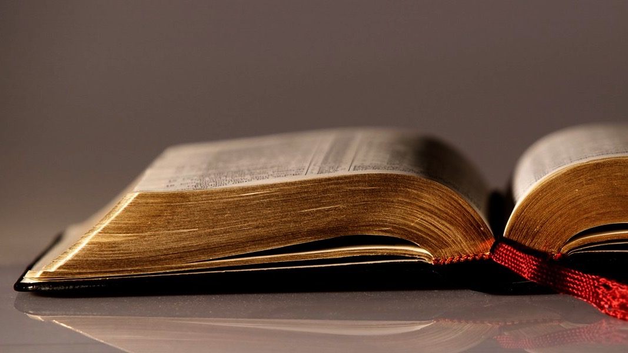
Welcome to
Our Sunday School
We’ll start at 9:07
visit OurSundaySchool.com for more about our class

Slide 2
Ephesians, week 6 (pages 36–46)

Slide 3
Hear: Ephesians 1

Slide 4
Ephesians 1:7–10
In Him we have redemption through His blood, the forgiveness of our transgressions, according to the riches of His grace which He caused to abound to us in all wisdom and insight, making known to us the mystery of His will, according to His good pleasure which He purposed in Him for an administration of the fullness of the times, that is, the summing up of all things in Christ, things in the heavens and things on the earth in Him.

Slide 5
Dr. John Stott
Doctrine leads to doxology as well as to duty

Slide 6
Ephesians, week 6 (pages 36–46)

Slide 7
Martin Bucer
Whatever is redeemed was once under someone else’s control

Slide 8
Colossians 1:13–14
Who rescued us from the authority of darkness, and transferred us to the kingdom of the Son of His love, in whom we have redemption, the forgiveness of sins.

Slide 9
Ephesians, week 6 (pages 36–46)

Slide 11
Dr. Frank Thielman
The NT unambiguously describes the blood of Christ as the ransom price for sinners

Slide 12
Ephesians, week 6 (pages 36–46)

Slide 13
BDAG on phronesis FRON-ee-sus
(1) the faculty of thoughtful planning
(2) the ability to understand, understanding, insight, intelligence

Slide 14
Ephesians, week 6 (pages 36–46)

Slide 15
Dr. Bryan Chapell
In the New Testament a mystery is not so much characterized by complexity or intrigue, as by timing. A mystery is a truth once hidden that is now revealed.

Slide 16
Ephesians, week 6 (pages 36–46)

Slide 17
Dr. Bryan Chapell
God revealed salvation to his people through the blood of his Son because it brings him pleasure

Slide 18
Matthew 3:17
and behold, there was a voice out of the heavens saying, “This is My beloved Son, in whom I am well-pleased.”

Slide 19
Ephesians, week 6 (pages 36–46)

Slide 20
BDAG on oikonomia oi-con-om-EE-uh
(1) responsibility of management
(2) state of being arranged, arrangement, order, plan

Slide 21
Ephesians, week 6 (pages 36–46)

Slide 22
Romans 13:9
For this, “You shall not commit adultery, You shall not murder, You shall not steal, You shall not covet,” and if there is any other commandment, it is summed up in this word, “You shall love your neighbor as yourself.”

Slide 23
Francis Foulkes
The word was used of gathering things together and presenting them as a whole. The Greek practice was to add up a column of figures and put the sum at the top.

Slide 24
1,000
100
200
300
400

Slide 25
Creation
Fall of man
Great Flood
Nation of Israel
Exodus from Egypt
OT sacrificial system
Priests, kings, and prophets
Captivity/rebuilding the temple
Life, death, resurrection, and ascension of Jesus
Church and apostles → right now → events in Revelation

Slide 26
Dr. Andrew Lincoln
[Ephesians] 1:10 then refers to the summing up and bringing together of the diverse elements of the cosmos in Christ as the focal point

Slide 27
Our Lord Jesus Christ
Creation
Fall of man
Great Flood
Nation of Israel
Exodus from Egypt
OT sacrificial system
Priests, kings, and prophets
Captivity/rebuilding the temple
Life, death, resurrection, and ascension of Jesus
Church and apostles → right now → events in Revelation

Slide 28
Dr. Darrell Bock
By God’s design, Jesus is the ultimate reference point for making sense of the creation

Slide 29
Our Lord Jesus Christ
Creation
Fall of man
Great Flood
Nation of Israel
Exodus from Egypt
OT sacrificial system
Priests, kings, and prophets
Captivity/rebuilding the temple
Life, death, resurrection, and ascension of Jesus
Church and apostles → right now → events in Revelation

Slide 30
Dr. Tony Merida
History is going somewhere

Slide 31
Our Lord Jesus Christ
Creation
Fall of man
Great Flood
Nation of Israel
Exodus from Egypt
OT sacrificial system
Priests, kings, and prophets
Captivity/rebuilding the temple
Life, death, resurrection, and ascension of Jesus
Church and apostles → right now → events in Revelation

Slide 32
Din Djarin
This is the way

Slide 33
Ephesians, week 6 (pages 36–46)

Slide 34
Dr. John MacArthur
History is written and directed by its Creator, who will see it through to the fulfillment of His own ultimate purpose—the summing up of all things in Christ.

Slide 35
Dr. John MacArthur
He designed His great plan in the ages past; He now sovereignly works it out according to His divine will; and in the fulness of the times He will complete and perfect it in His Son,

Slide 36
Dr. John MacArthur
in whom it will forever operate in righteous harmony and glorious newness along with all things in the heavens and things upon the earth.

Slide 37
Next time: Ephesians 1:11–12 (pp. 46–51)

Slide 38
Commentaries
Quotes are due to Jim by Thursday night
If you would like one, let Jim know

Slide 39
Prayer time
Write down your prayer requests (on the Weekly Update or in the comments)
Lean in, engage, and pray for someone not with you
Be out of this room by 9:50
Go worship

